Slide 1
Comparative Evaluation of Call Graph Generation by Profiling Tools
Onur Cankur, Abhinav Bhatele
Department of Computer Science

Slide 2
Introduction
Analyzing the performance of parallel programs is critical but challenging.
Profiling tools allow for measuring performance data.
Different profiling methods and capabilities.
Comparatively evaluate call graph data generation capabilities of several profiling tools.

Slide 3
Overview
Comparatively evaluate call graph data generation capabilities of several profiling tools.
Profiling Tools
Profiling Tools
Proxy Apps
Proxy Apps
Evaluation Metrics
•
Caliper 2.6.0
•
AMG
1.
Runtime Overhead
•
HPCToolkit
•
LULESH
2.
Memory Usage
2021.05.15
•
Quicksilver
3.
Data Size
•
Score
-
P 7.1
4.
Data Correctness
•
TAU 2.30.1
5.
Data Richness

Slide 4
Experimental Setup
Profiling Tools
Proxy Apps
Evaluation Metrics
Environment
Evaluation Metrics
Environment
•
Caliper
2
.
6
.
0
•
AM
G
•
•
Runtime
•
GCC
8
.
3
.
1
•
HPCToolkit
•
LULESH
Overhead
•
Open MPI
2021
.
05
.
15
•
Quicksilver
•
Memory
Usage
3.0.1
•
Score
•
Data
Size
-
P
7
.
1
•
x86_64
•
TAU
2
•
Data
Correctness
.
30
.
1
architecture
•
Data
Richness
•
All applications are written in C/C++ and use only MPI.
•
Weak scaling experiments.
•
Sampling and instrumentation methods are evaluated separately.

Slide 5
Different Methods for Profiling
Instrumentation
Instrument the source or binary code.
Collect performance measurements at each instrumentation point.
Can be done by the user or the tool itself.
Sampling
Periodically sample the program, check the PC and collect function call stack.
Aggregate the performance measurements of a code block across multiple samples.

Slide 6
Comparison 1: Runtime Overhead
The execution time of an application should not be perturbed significantly by the profiling tool.
Measure the time using MPI_Wtime().
$$Relative Execution Time=\frac{MPI_Wtime(with_profiling)}{MPI_Wtime(without_profiling)}$$

Slide 7
Evaluation 1: Runtime Overhead
Varying sampling intervals.
Each execution used 64 MPI processes.
Default instrumentation methods.

Slide 8
Evaluation 1: Runtime Overhead
Default sampling intervals.
20, 5, 10, 30 ms for Caliper, HPCToolkit, Score-P, and TAU, respectively.

Slide 9
Comparison 2: Memory Consumption
Performance tools should not consume large amounts of memory.
Obtain the largest memory usage at any point during program execution using getrusage().
$$AMU=getrusage\left(with_profiling\right)−getrusage(without_profiling)$$
AMU: Additional Memory Usage

Slide 10
Evaluation 2: Memory Consumption
Varying sampling intervals.
Each execution used 64 MPI processes.
Default instrumentation methods.

Slide 11
Information Gathered by Profiling Tools
CCT: tree of call paths
Call path: sequence of function invocations
Refer as “Call Graph”

Slide 12
Comparison 3: Size of Call Graph Data
Profiling tools generate significant amount of call graph data.
Use default settings and collect per-process data.
Compare which tool generates more data.
Generating more data might not be a downside.
Further analysis on the call graph data is needed.

Slide 13
Evaluation 3: Generated Data Size
Varying sampling intervals.
Each execution used 64 MPI processes.
Default instrumentation methods.

Slide 14
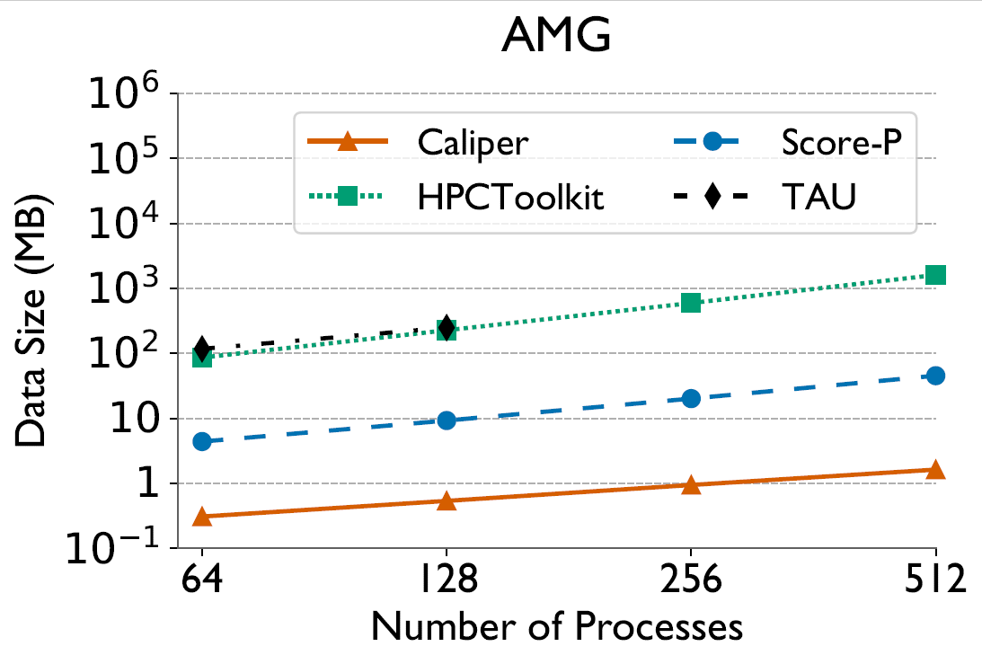
Evaluation 3: Generated Data Size
Default sampling intervals.
20, 5, 10, 30 ms for Caliper, HPCToolkit, Score-P, and TAU, respectively.

Slide 15
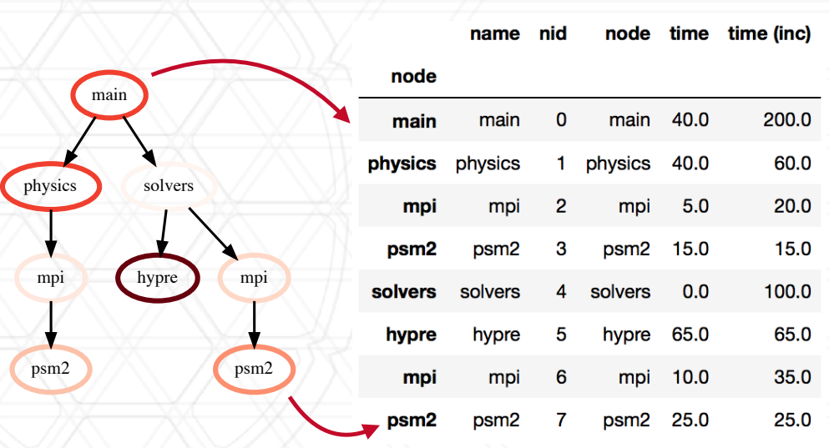
Post-mortem Analysis
Hatchet
Programmatically analyze call graph data
Graphframe = graph + dataframe

Slide 16
Comparison 4: Correctness of Call Graph Data
Assumption: If the data generated by multiple tools is nearly identical, it should be close to the ground truth.
Default settings are used for each tool.

Slide 17
Comparison 4: Correctness of Call Graph Data
Comparison Metrics
Rationale
Top five slowest
Do tools identify the same slowest nodes?
call graph
nodes
Call path of the
Can tools provide the correct program
slowest nodes
structure?
File
Can tools provide correct information about the
source code?
Line number
Hot nodes
Do tools identify the same most time
-
consuming call path?

Slide 18
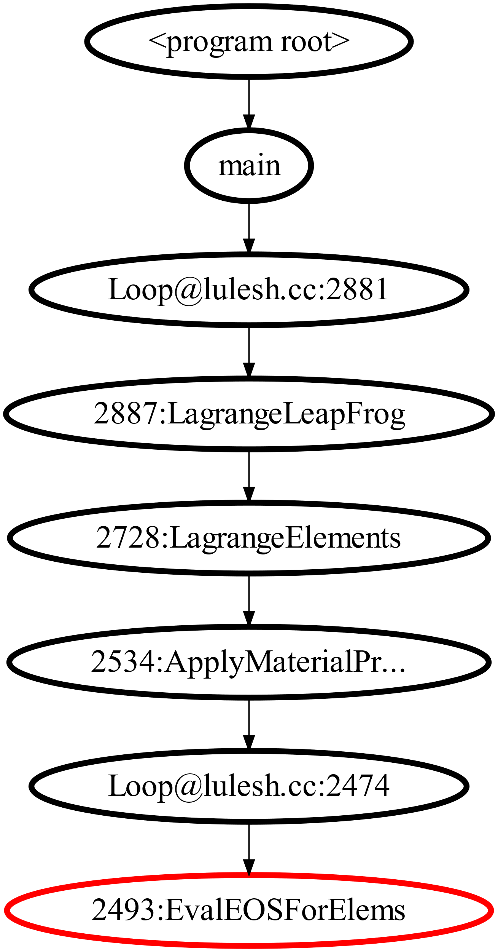
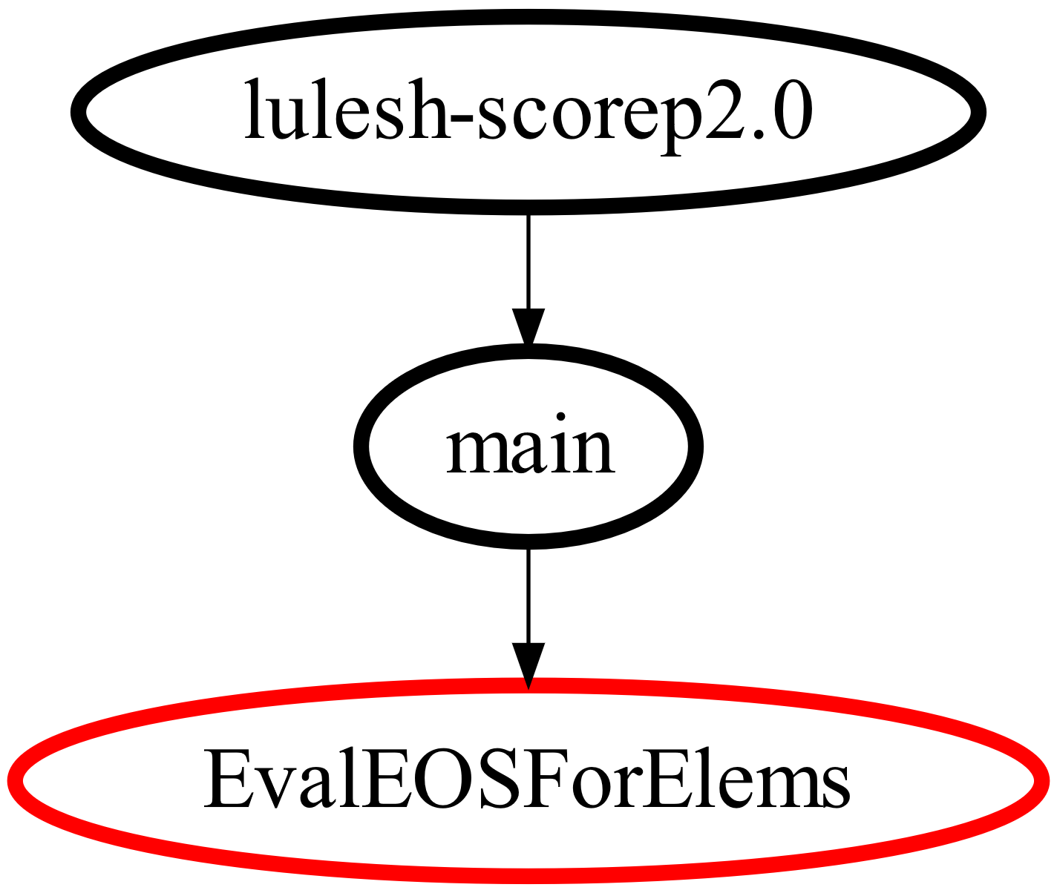
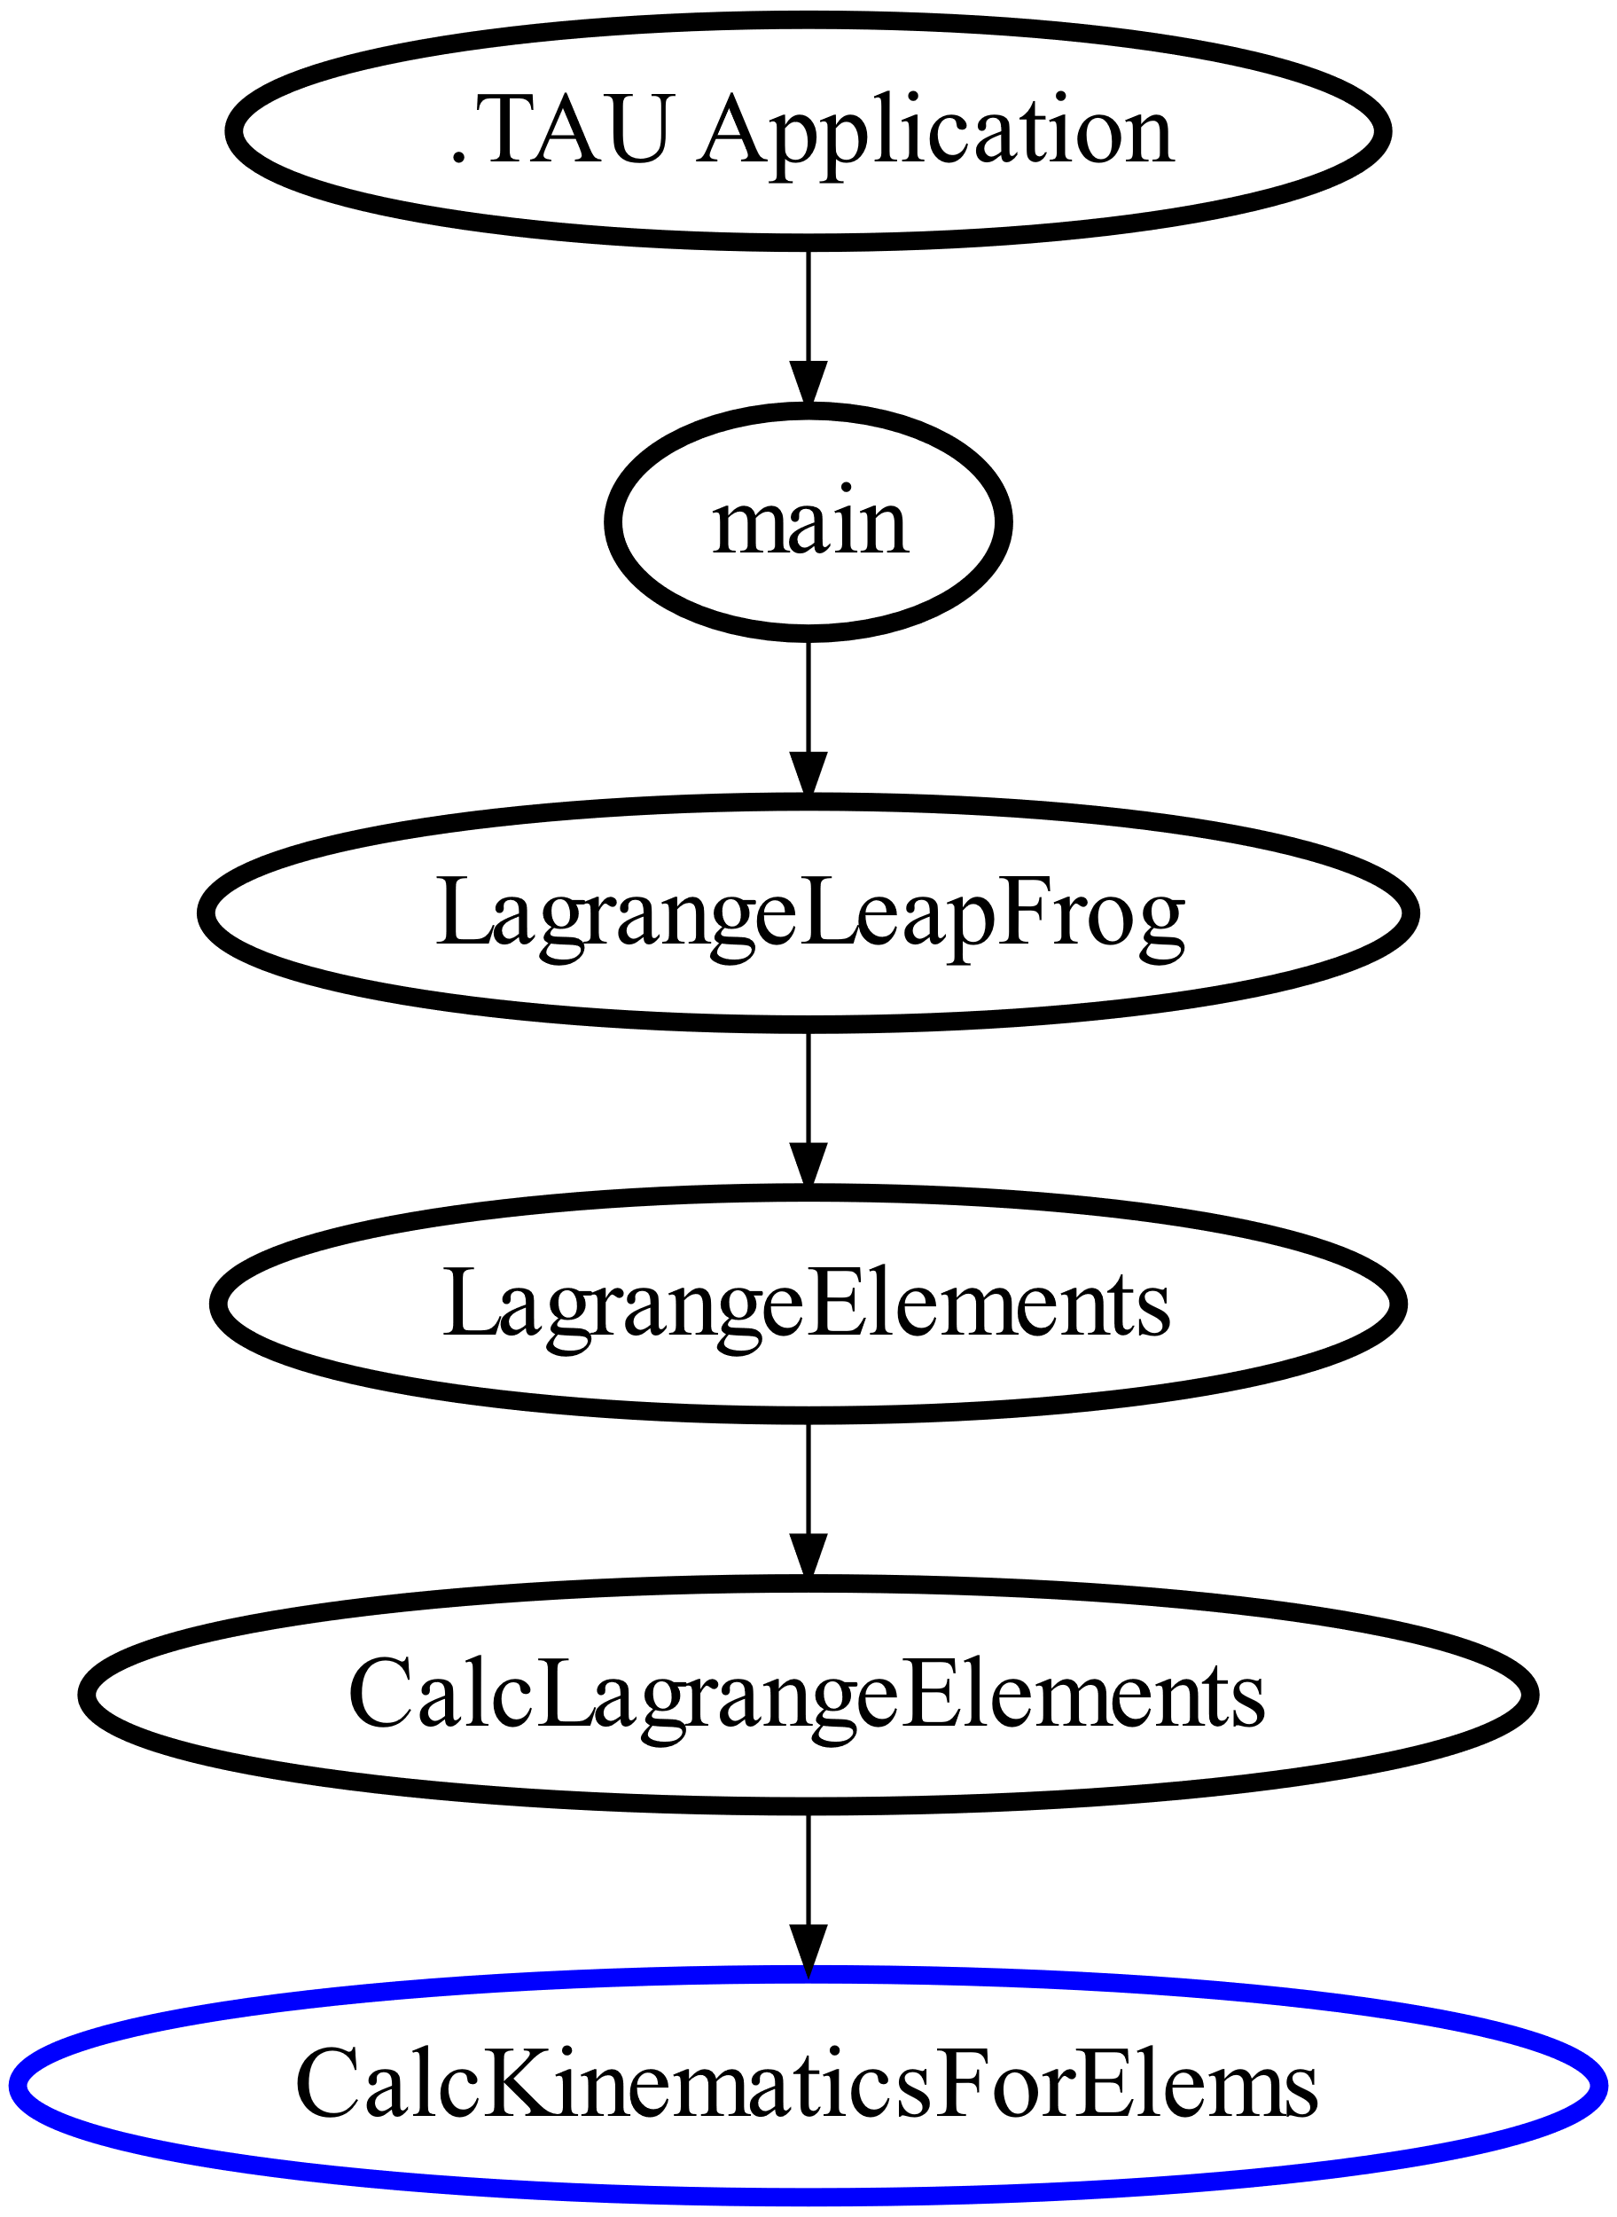
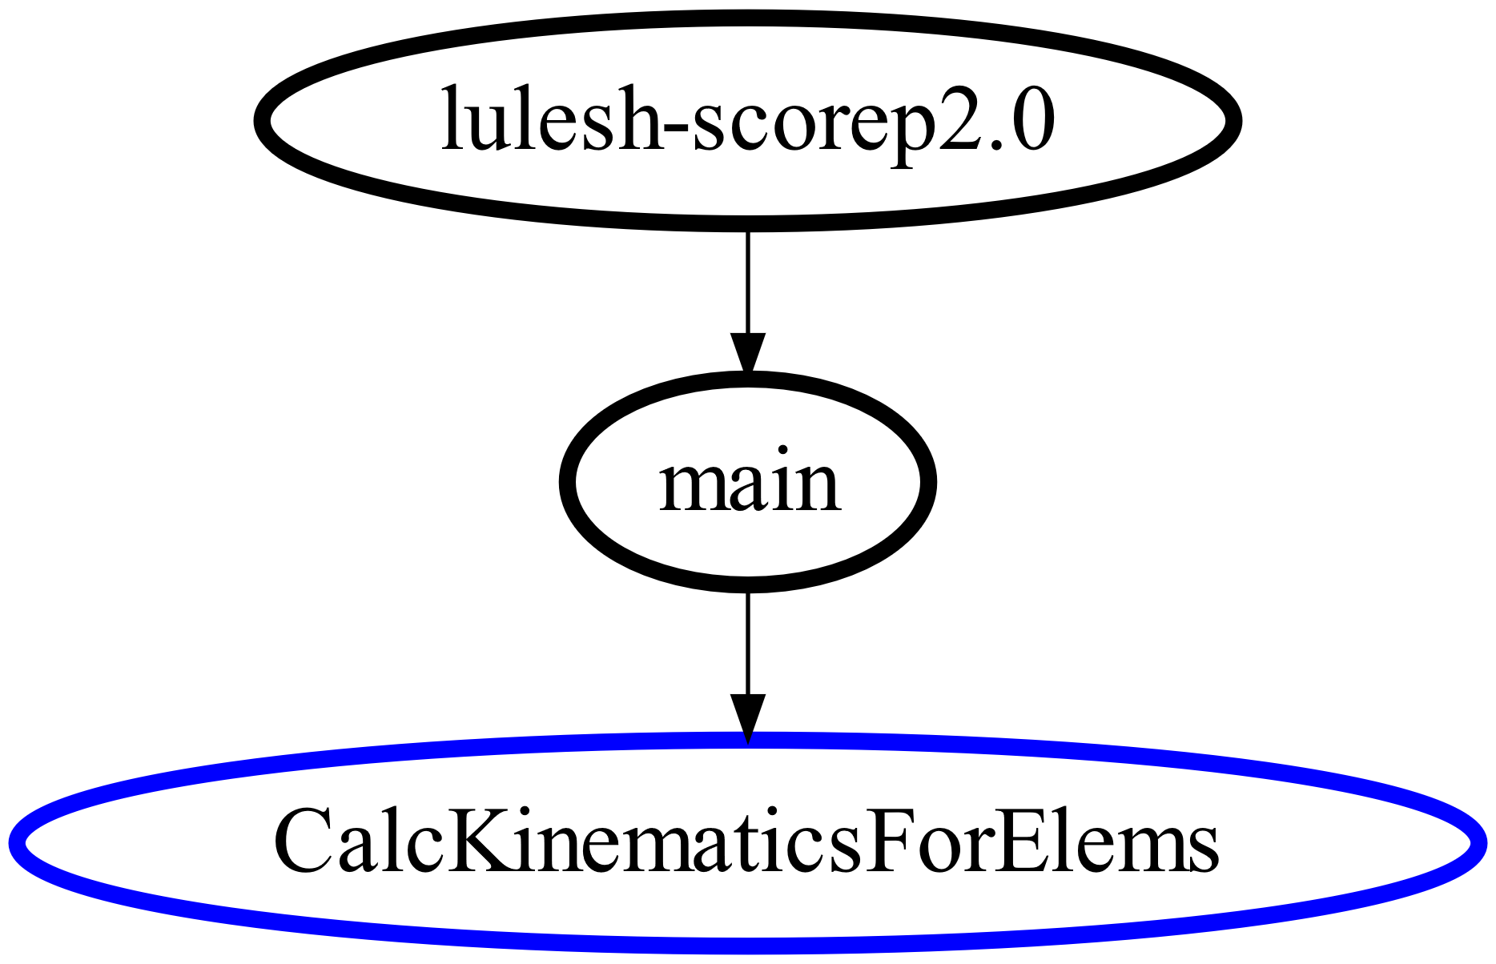
Evaluation 4: Call Path Correctness
Call path of the second slowest node obtained by different tools for LULESH.
The leaf nodes are the second slowest nodes.
But the tools agree on the slowest node.
(b) Score-P (sampling)
(d) TAU (instrumentation)
(c) Score-P (instrumentation)
(a) HPCTookit

Slide 19
Top 5
Caliper
HPCToolkit
Score
-
P
TAU
(
inst,samp
)
(
samp
)
(
inst
,
samp
)
(
inst
,
samp
)
1st
CalcHourglassCo
CalcHourglassContr
main, main
CalcHourglassControl
ntrolForElems
olForElems
ForElems
,
,
syscall
progress_engine
2nd
CalcFBHourglassF
EvalEOSForElems
CalcKinematicsFo
CalcKinematicsForEle
rElems
orceForElems
,
ms
,
,
/lulesh.cc:1062
EvalEOSForElems
__
poll_nocancel
3rd
IntegrateStressFor
CalcFBHourglassForc
Release(),
IntegrateStressForEle
Elems
ms
,
eForElems
CalcFBHourglassF
,
/lulesh.cc:1066
orElems
addr
=<2aaac53e0670>
4th
CalcEnergyForElem,
CalcMonotonicQRegi
MPI_Allreduce
,
CalcFBHourglassForce
onForElems
MPI_Allreduce
ForElems
/lulesh.cc:1064
,
_
poll_nocancel
5th
EvalEOSForElem
EvalEOSForElems
,
CalcEnergyForElems
CalcElemVolum
,
,
/lulesh.cc:1065
free
.TAU application

Slide 20
Comparison 5: Richness of Call Graph Data
Richness of call graph profiling data refers to having detailed information in the call graph.
Default settings are used for each tool.

Slide 21
Comparison 5: Richness of Call Graph Data
Comparison Metrics
Rationale
Max. call path length
Investigate:
Max. call path length
•
If the call graph data provides
Avg. call path length
Avg. call path length
sufficient information.
Number of nodes
Number of nodes
•
If the call graph data has some
Number of .so files
abnormalities.
Number of MPI
functions

Slide 22
Evaluation 5: Call Path Richness
Fixed sampling interval (20.0 ms)
Default instrumentation methods.
Each execution used 64 MPI processes.

Slide 23
Summary
The first empirical study on call graph data generation capabilities of profiling tools.
Evaluated Caliper, HPCToolkit, Score-P, and TAU.
Considered runtime overhead, memory consumption, and the size and quality of the generated call graph data.

Slide 24
Joshua Harless
3101 Turner Hall, College Park, MD 20742
301.405.3384 / jharless@umd.edu

Slide 25
Evaluation 4: Call Path Correctness
 | Caliper (inst,samp) | HPCToolkit (samp) | Score-P (inst, samp) | TAU (inst, samp)
1st | CalcHourglassControlForElems, syscall | CalcHourglassControlForElems | main, main | CalcHourglassControlForElems, progress_engine
2nd | CalcFBHourglassForceForElems, /lulesh.cc:1062 | EvalEOSForElems | CalcKinematicsForElems, EvalEOSForElems | CalcKinematicsForElems, __poll_nocancel
3rd | IntegrateStressForElems, /lulesh.cc:1066 | CalcFBHourglassForceForElems | Release(), CalcFBHourglassForElems | IntegrateStressForElems, addr=<2aaac53e0670>
4th | CalcEnergyForElem, /lulesh.cc:1064 | CalcMonotonicQRegionForElems | MPI_Allreduce, MPI_Allreduce | CalcFBHourglassForceForElems, _poll_nocancel
5th | EvalEOSForElem, /lulesh.cc:1065 | CalcEnergyForElems | CalcElemVolum, free | EvalEOSForElems, .TAU application

