Slide 1
Continuous Clock SynchroniZation for Accurate Performance Analysis
Johannes Ziegenbalg
Scalable Tools Workshop, 07 August 2017

Slide 2
OUTLINE
  Motivation
  Challenges
  One-Time Synchronization
  Continuous Clock Synchronization
  Multi-stage Synchronization
  Conclusion

Slide 3
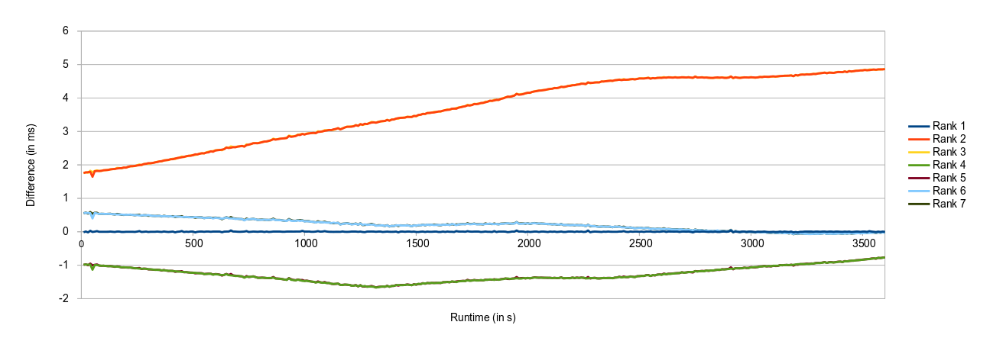
MOTIVATION
  Accurate performance analysis
  Lack of an system-wide timer
  Different initial clock properties and changes over time

Slide 4

CHALLENGES
© Heinz Zak: Wolfgang Güllich climbing “separate reality”
  Large initial timestamp differences
  Differences in clock speed
  Clock acceleration due to physical effects and NTP corrections
Notes:
Foto: Wolfgang guellich “separate reality” CC Heinz Zak

Slide 5
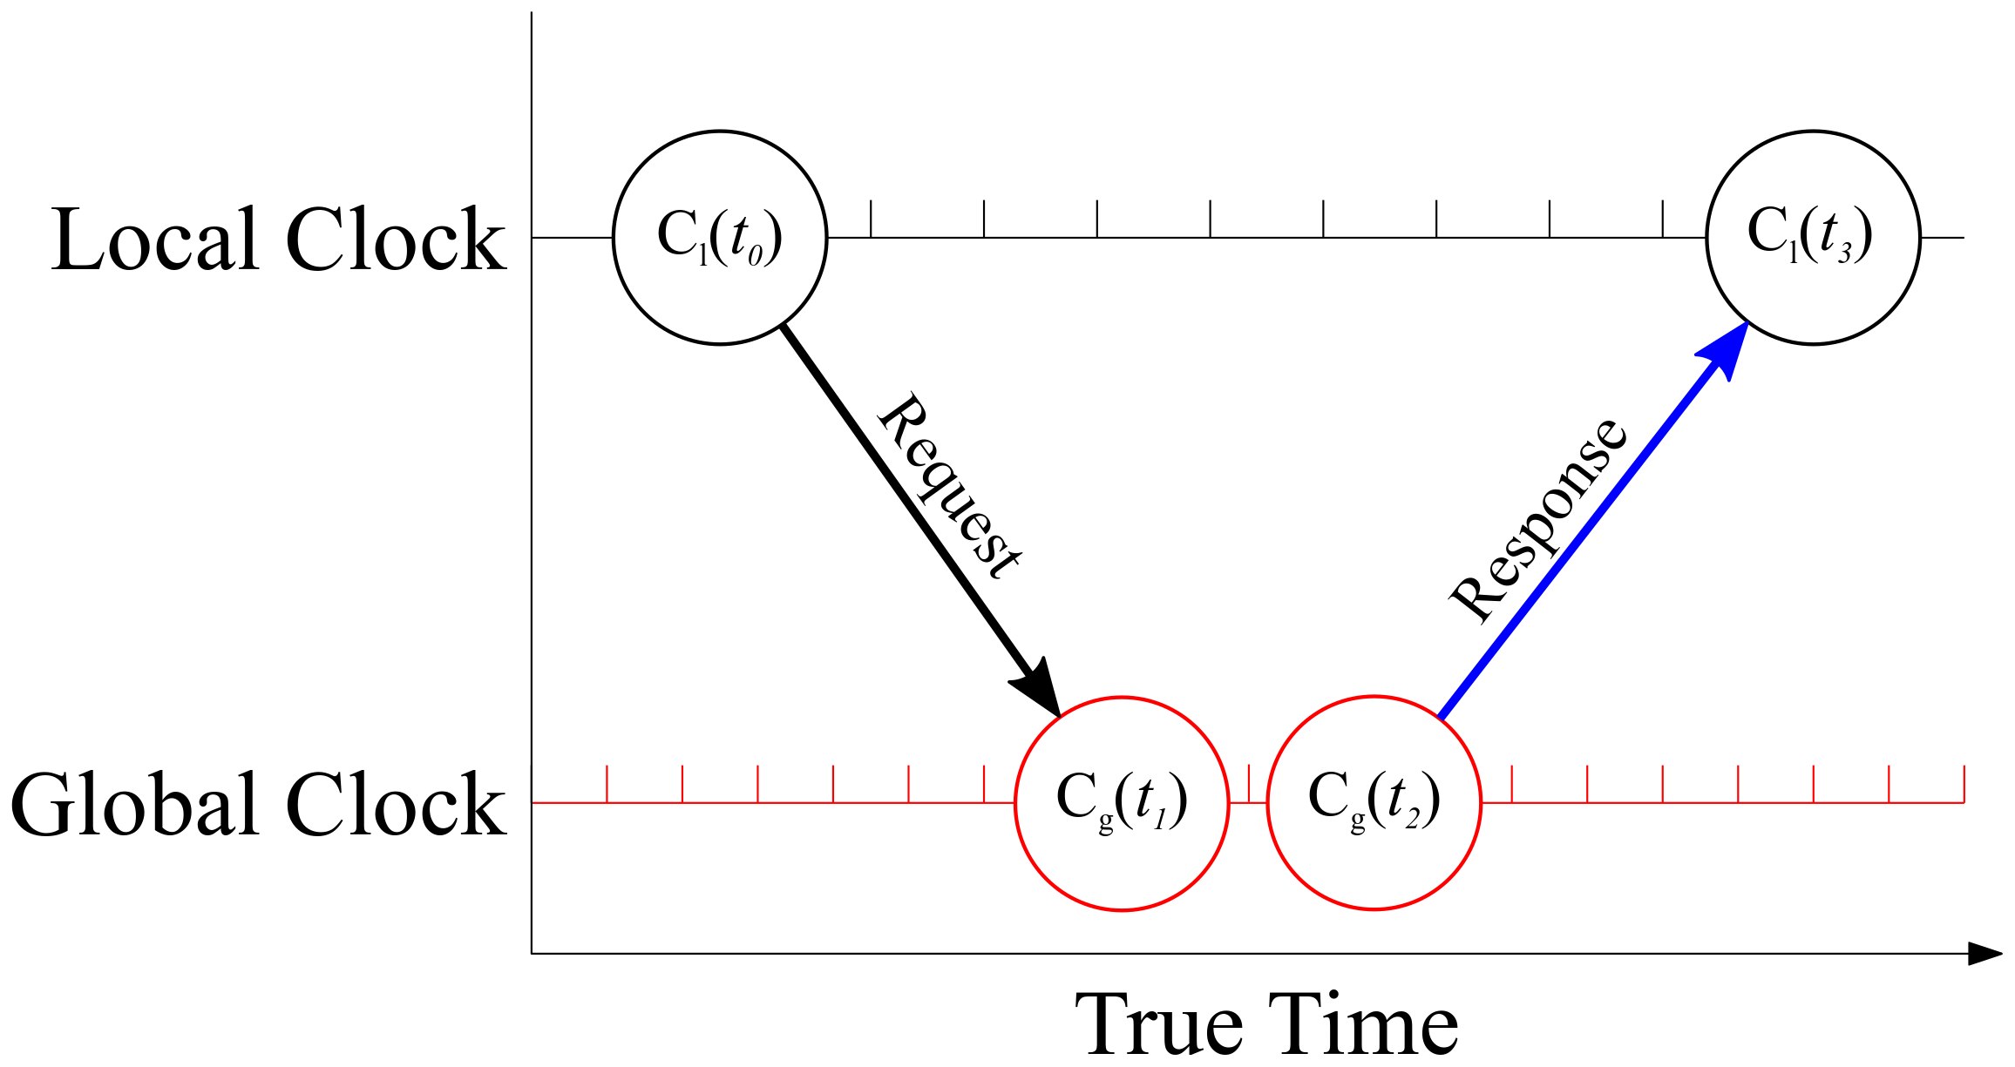
BASICS
  Local clock requesting timestamps from global one
  Intercept – the absolute time offset between two clocks
  Slope – the speed difference of two clocks

Slide 6
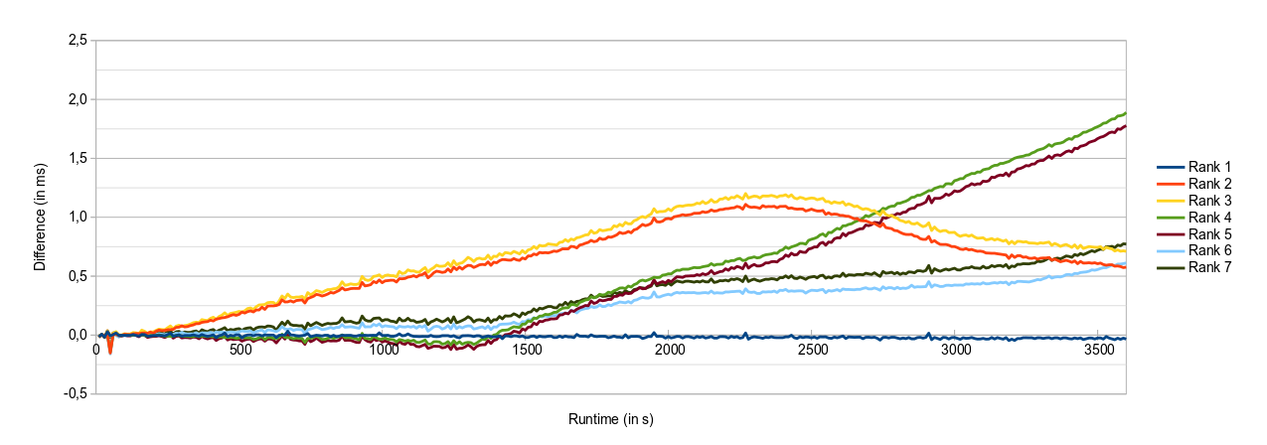
ONE-TIME SYNCHRONIZATION
Clock differences to Rank 0 after a single synchronization step in the beginning

Slide 7
CONTINUOUS SYNCHRONIZATION
  Inject “clock-sync” Messages – attach Timestamps (t₀ - t₃)
  Many measurement points over time
  Compute slope/intercept of local clock

Slide 8
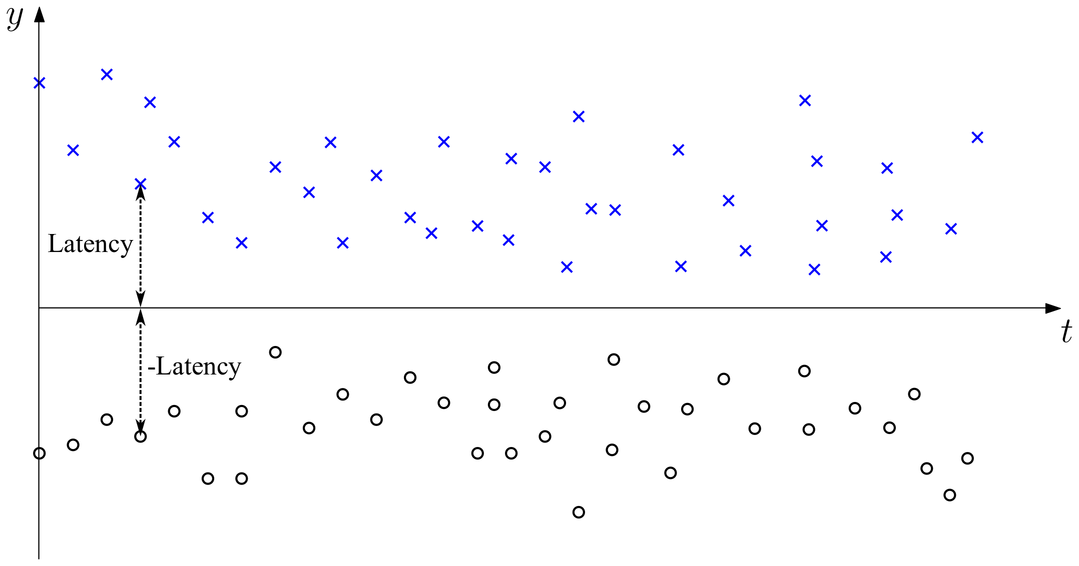
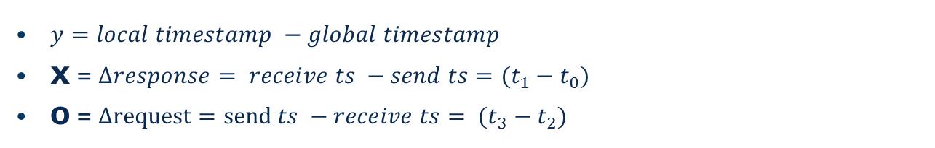
CONTINUOUS SYNCHRONIZATION – SYNCHRONOUS CLOCK
  $y=local timestamp −global timestamp$
  X = $∆response= receive ts −send ts=(t_{1}−t_{0})$
  O = $∆request=send ts −receive ts= (t_{3}−t_{2})$

Slide 9
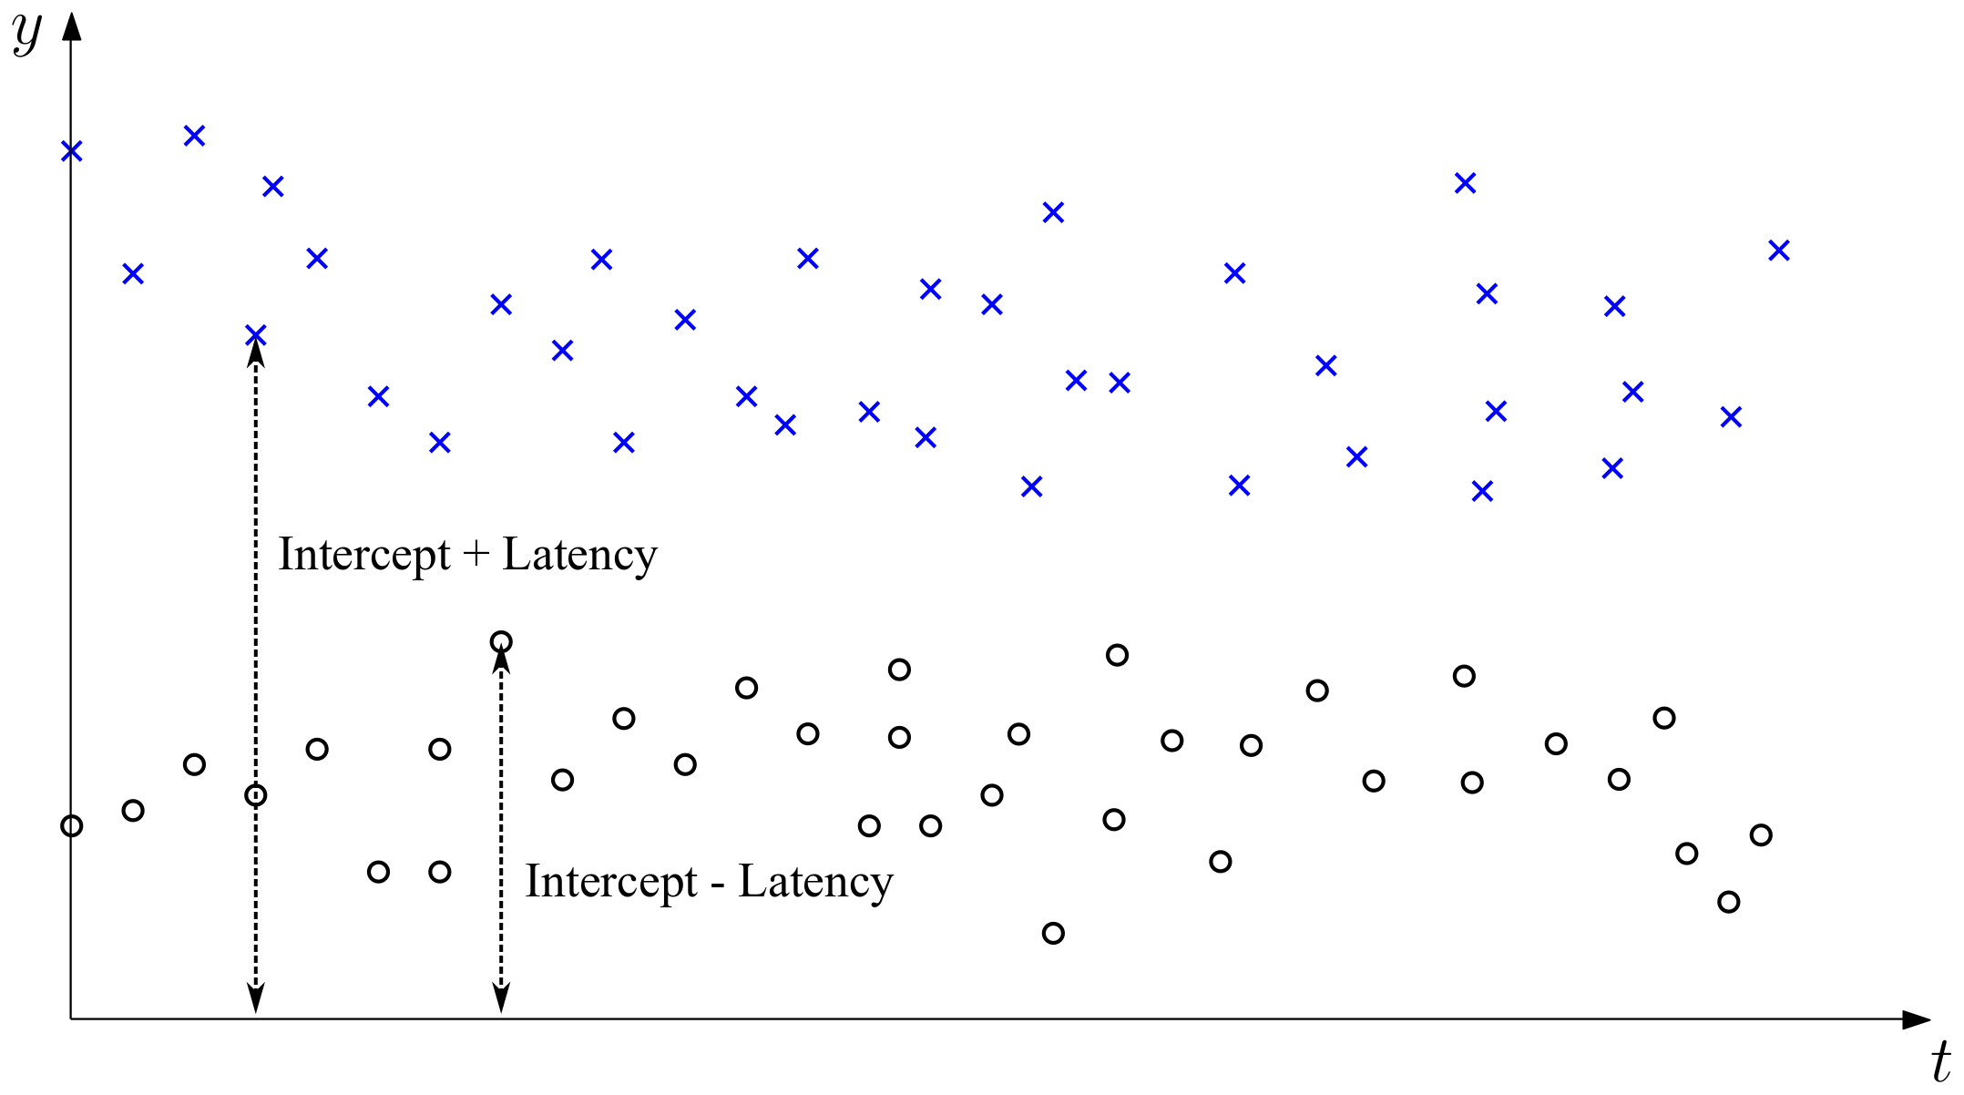
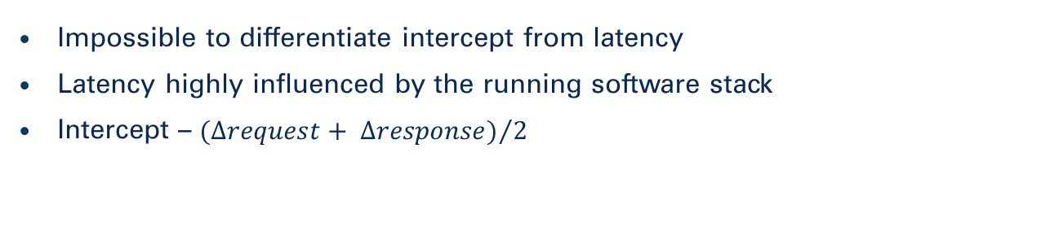
INTERCEPT COMPUTATION
  Impossible to differentiate intercept from latency
  Latency highly influenced by the running software stack
  Intercept – ${(∆request+ ∆response)}/2$

Slide 10
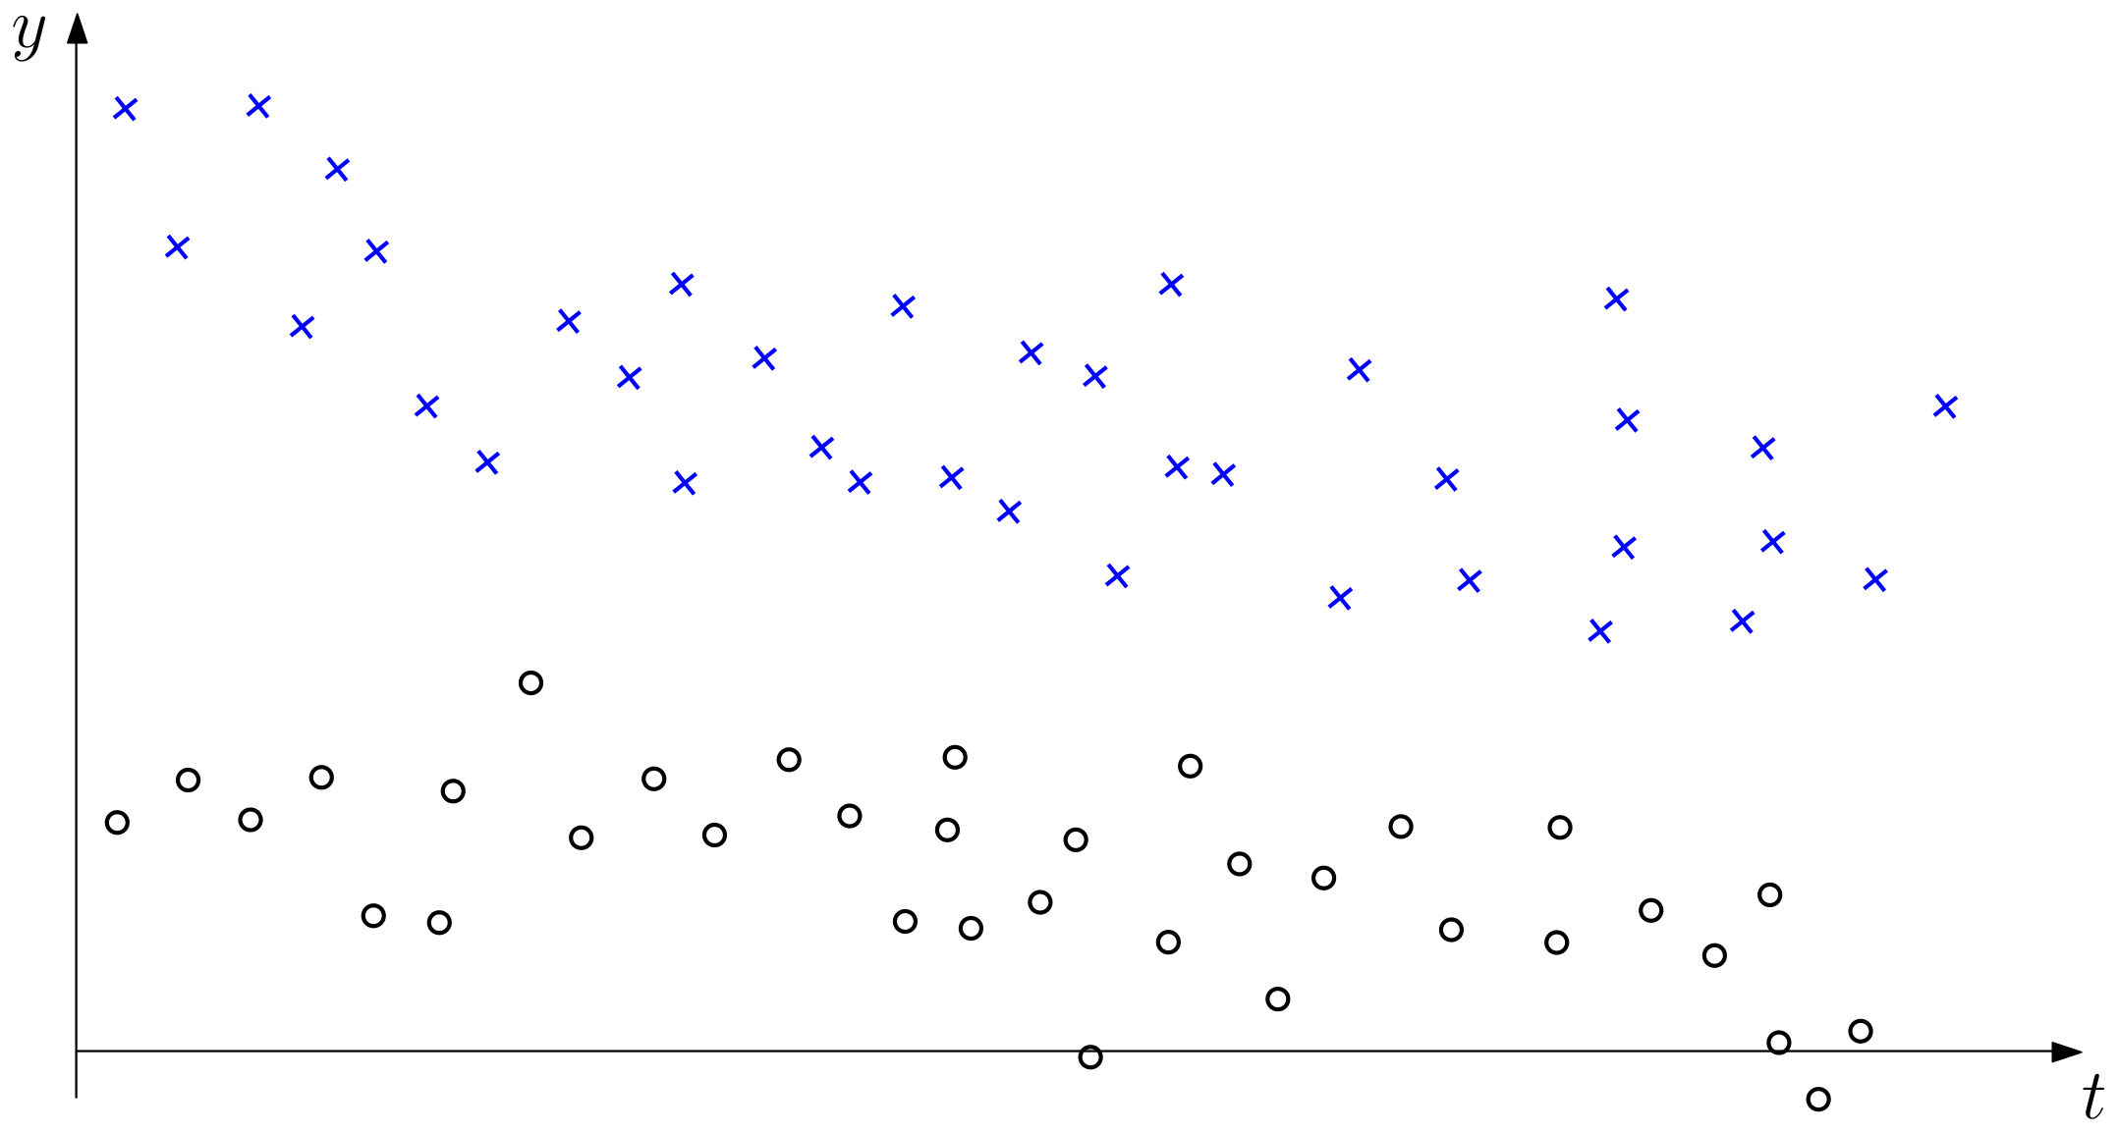
SLOPE COMPUTATION
  Linear regression is not feasible – too complex
  Consider only messages with lowest latency
  Low latency messages defined by convex hulls

Slide 11
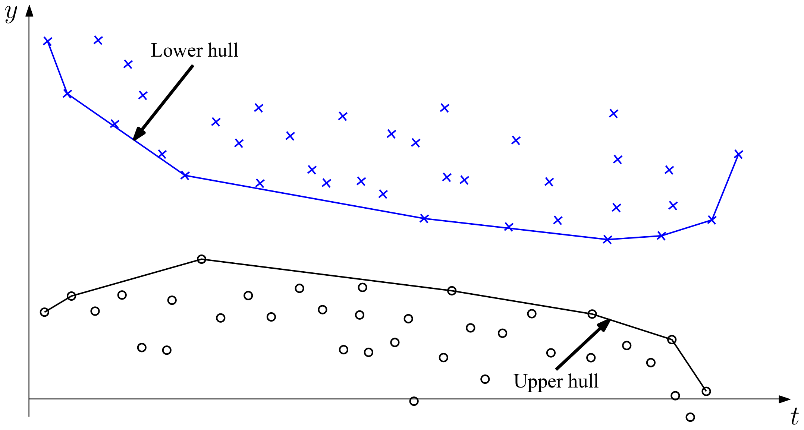
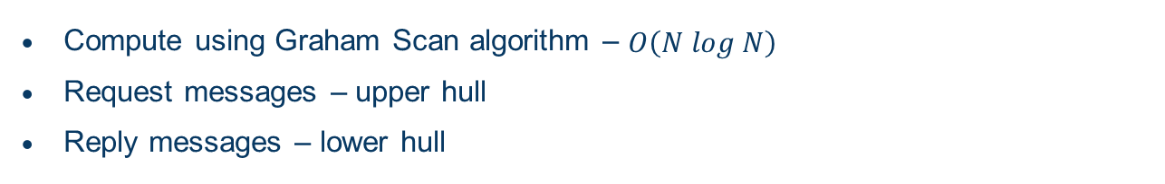
CONVEX HULL
  Compute using Graham Scan algorithm – $O\left(N log N\right)$
  Request messages – upper hull
  Reply messages – lower hull

Slide 12
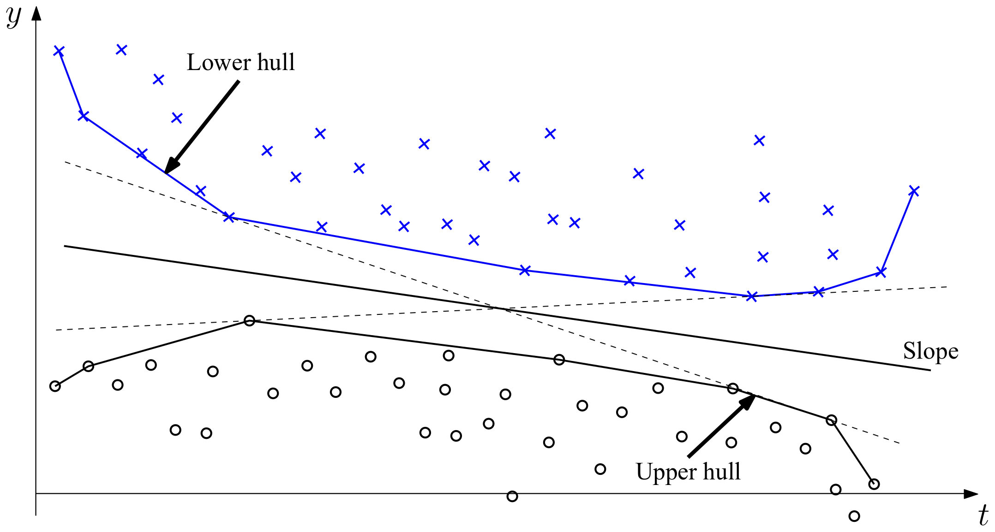
SLOPE SELECTION
  Many possibilities
  Compute tangents between polygons (convex hulls)
  Slope of clock equals to slope of angle bisector

Slide 13
MULTI-STAGE SYNCHRONISATION
  Global clock will become a bottleneck
  Hierarchical arrangement of communication pairs
  Loss of accuracy due to intermediate timestamp translation

Slide 14
CONCLUSIONS
  Scalable infrastructure for synchronizing clocks
  Synchronization during runtime
  Adjust to clock effects – tradeoff accuracy vs. responsiveness
  Works with long running applications

